Slide 1

Basic MP3 Player

Slide 2
Agenda
Project Scope
Features
UI & Design
Technology Used
Implementation and Verification

Slide 3

Project Scope
Design and Implement a Basic UI MP3 Player with Basic controls using Python

Slide 4
Features
Selection of multiple files (Mp3 and M4a format)
Implement Controls
Play ( Play the song from the list)
Stop ( When stop control clicked, Song should stop)
Pause ( When pause control clicked , Song should be paused, when Play control clicked it should start from where Song was paused )
Next
Previous

Slide 5
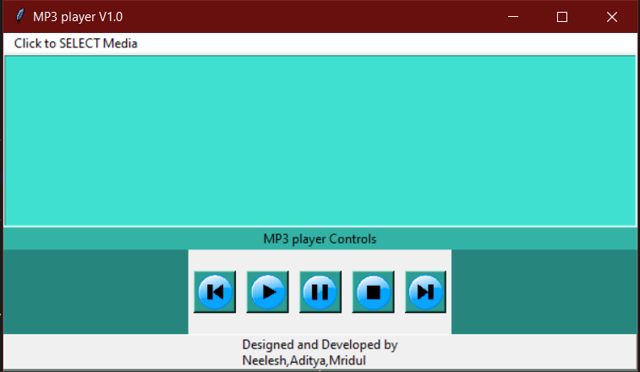
UI and Design

Slide 6

Development Environment
Python 3.9.0 on Windows
Modules used: Tkinter Pygame

Slide 7
Implementation and Verification Approch
Design the flow of Controls
Example Play , Stop Play, Pause…
Implementation
Started with basic functionality like Play control, Stop Control
Built other controls and combinations like PLAY-STOP-NEXT-PAUSE-PALY
Used functions to eliminate code duplication
Verification
Tested basic controls
Tested combinations

